Slide 1


Data Management and Database Design
Role-based access control
Group 20
Presented by,
Ashwin Muthiah Murugappan
Vijayalakshmi Siddappa
Naga Mahesh Tiruveedhula

Slide 2
Role Based Access Control
Role-based access control (RBAC) is a method of restricting network access based on the roles of individual users within an enterprise.
RBAC lets employees have access rights only to the information they need to do their jobs and prevents them from accessing information that doesn't pertain to them.
In the role-based access control data model, roles are based on several factors, including authorization, responsibility and job competency.
As such, companies can designate whether a user is an end user, an administrator or a specialist user. In addition, access to computer resources can be limited to specific tasks, such as the ability to view, create or modify files.
Limiting network access is important for organizations that have many workers, employ contractors or permit access to third parties, like customers and vendors, making it difficult to monitor network access effectively.
Companies that depend on RBAC are better able to secure their sensitive data and critical applications.
Benefits - Improves operational efficiency, Enhances compliance, Giving administrators increased visibility, Reduces costs, Decreases risk of breaches and data leakage.

Slide 3
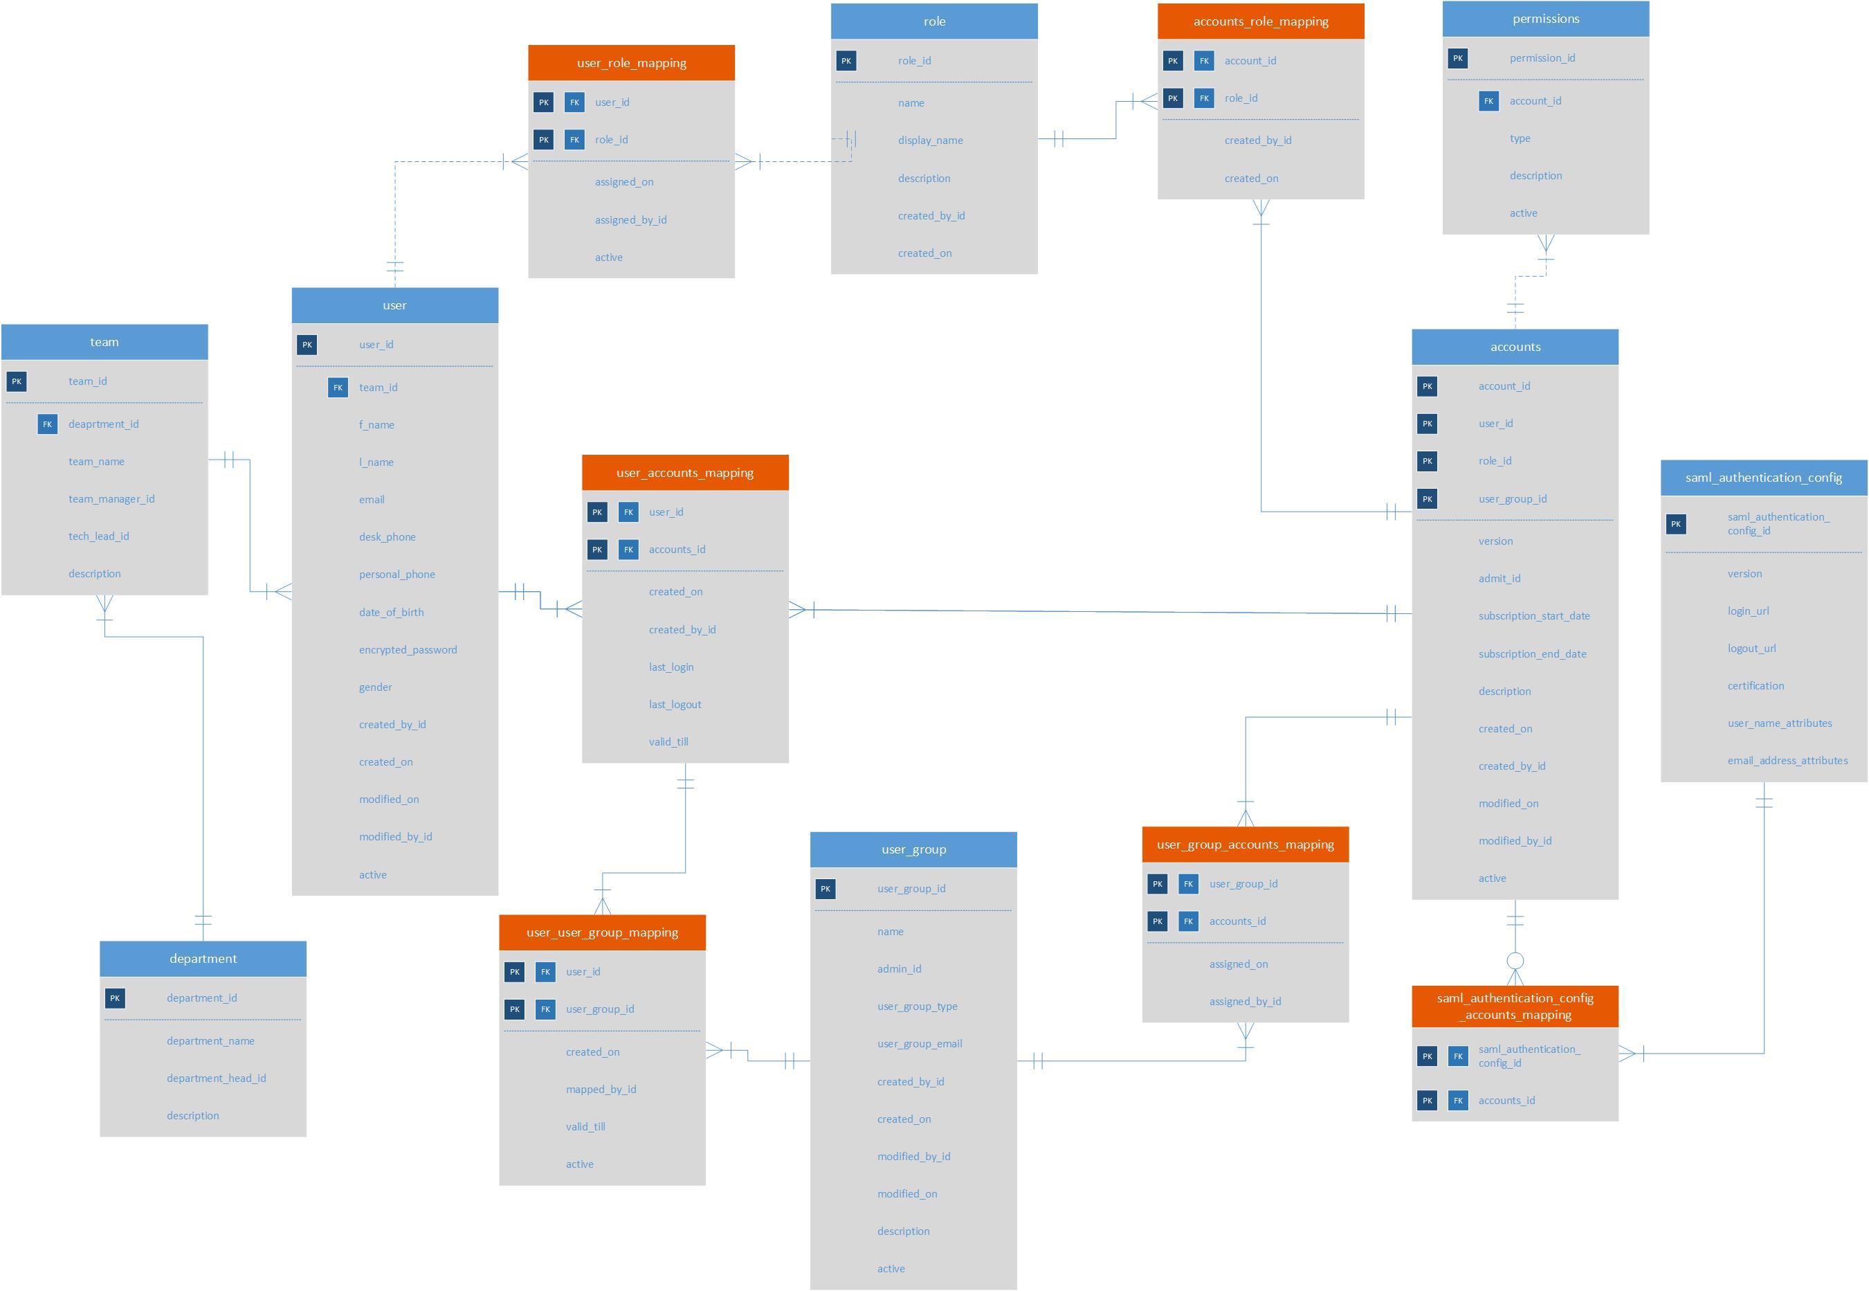
Entity Relationship Diagram

Slide 4
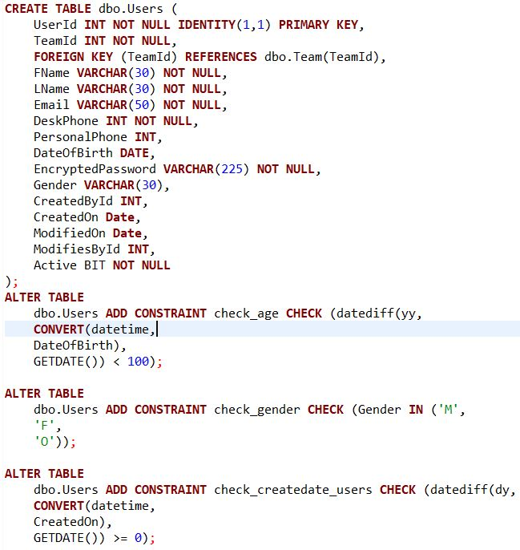

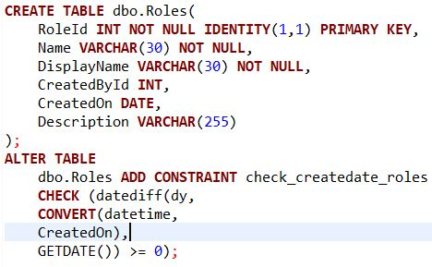
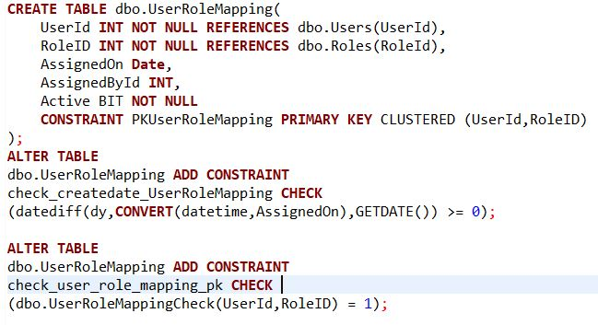
SQL DDL User - Role -UserRoleMapping
Let’s look at the entities USER , Role and User role mapping .
The UserRoleMapping entity is an Associative table .
The Associative Tables are used for Normalizing a many to many relationship between the User and the Role entity.

Slide 5
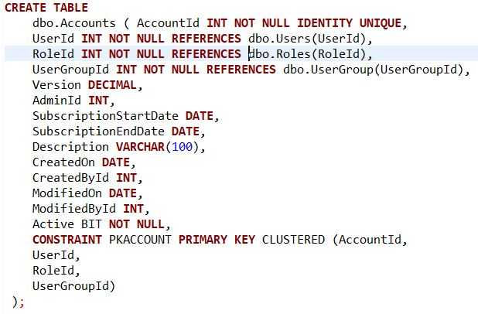
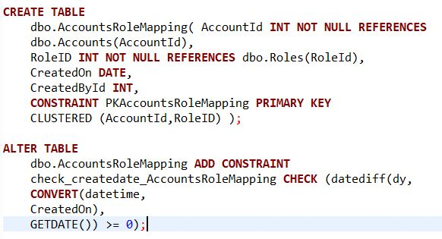
SQL DDL
Role - Accounts - AccountRoleMapping
Let’s look at the entities Role, Accounts and AccountRoleMapping.
The AccountRoleMapping entity is an Associative table .
The Associative Tables are used for Normalizing a many to many relationship between the Roles and the Accounts entity.

Slide 6
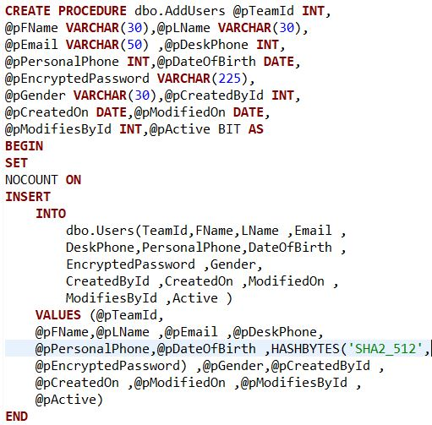
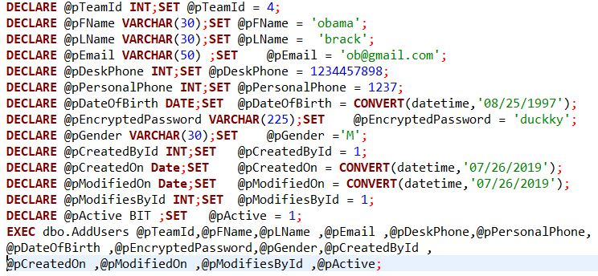
SQL DDL Password Encryption - Stored procedures
Stored Procedures were used for inserting data into User Entity with Password Encryption .
HASHBYTES (Transact-SQL) was used to convert the Actual Password into an Encrypted form .

Slide 7
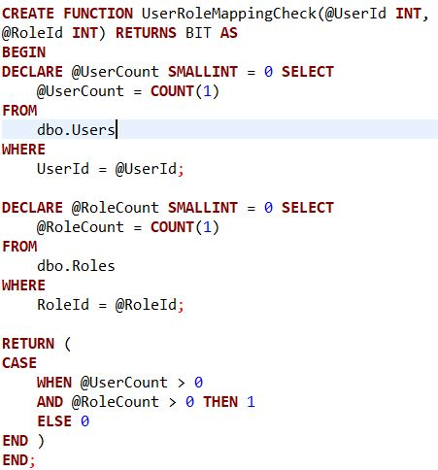
SQL DDL Function - Check Constrains
A user-defined function (UDF) in SQL Server is a programming construct that accepts parameters, does work that typically makes use of the accepted parameters, and returns a type of result.
Here, the function Accepts the Role Id and User Id and checks if they are present in the User and Role tables Respectively.
If present the function returns or else it returns 1.

Slide 8
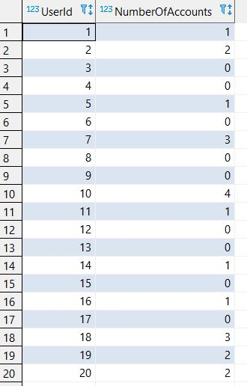

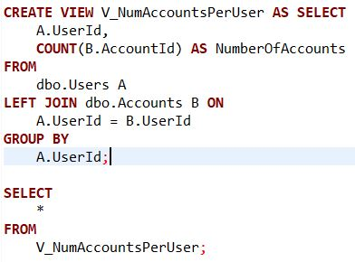
Views
In SQL, a view is a virtual table based on the result-set of an SQL statement. A view contains rows and columns, just like a real table.
The fields in a view are fields from one or more real tables in the database.
This View on the right is used to report the Number of accounts per user.

Slide 9
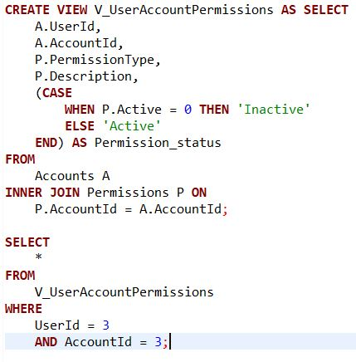
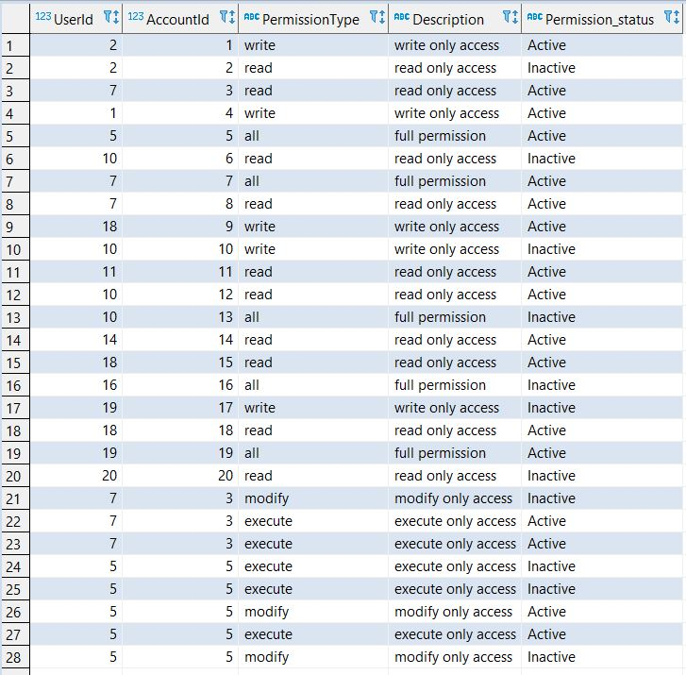
Views
This view takes in a particular user and a particular account and specifies all the permissions for that user for that account.
For this example we have used the UserId = 3 and AcccountId = 3.

Slide 10
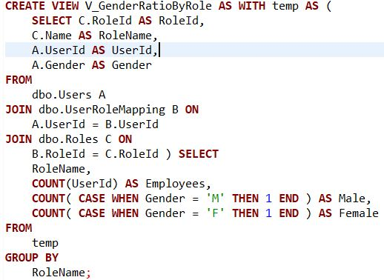
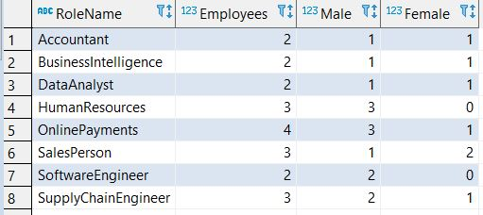
Views
This view gives the number of male and female employees for each role.
We can see that ratio of female is higher in the sales related role.

Slide 11
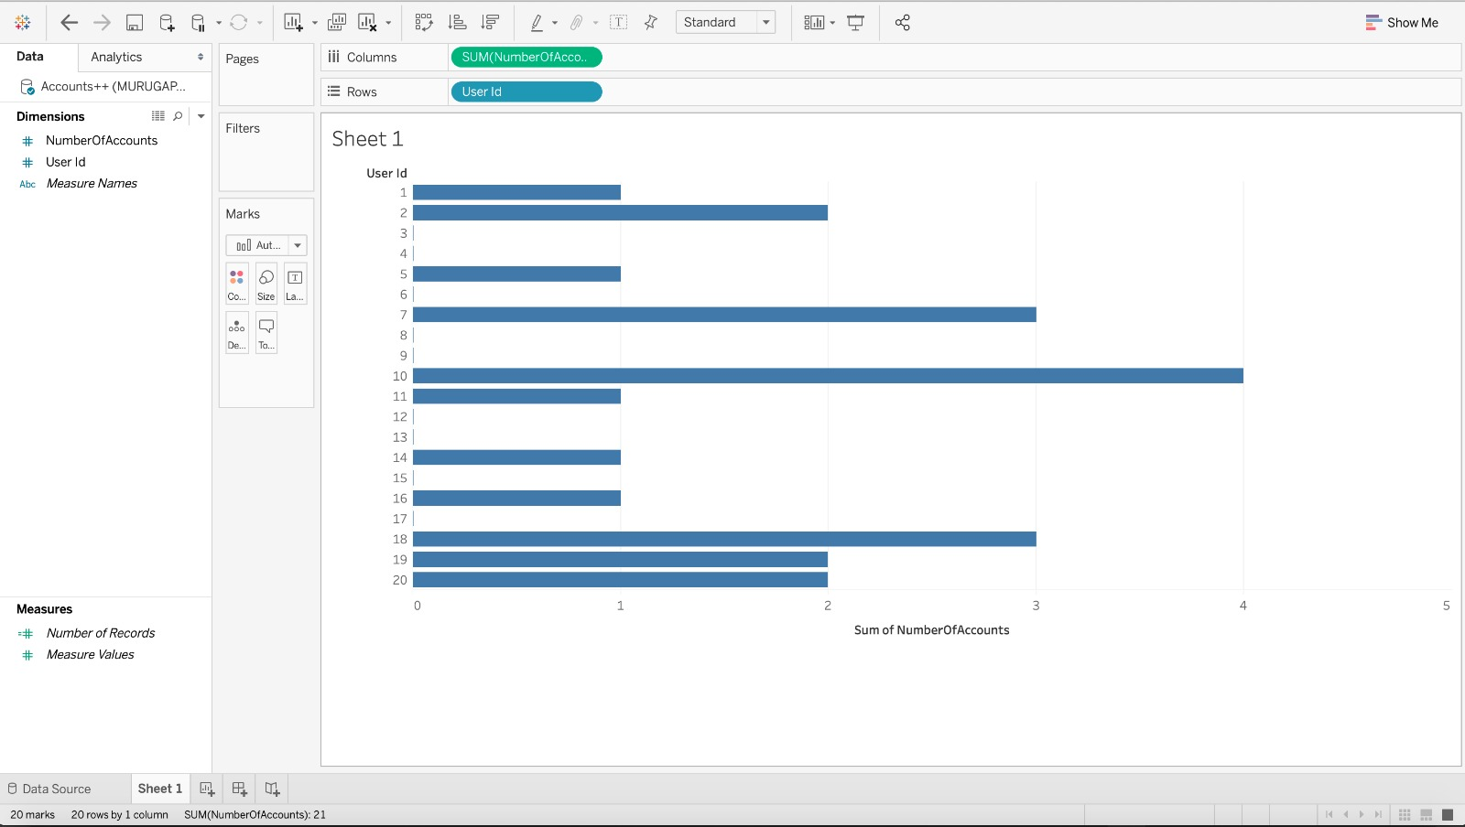
Reports and Visualization
Report shows number of accounts each user has.
Sum of NumberOfAccounts is on the X-axis
UserId is on the Y-Axis

Slide 12
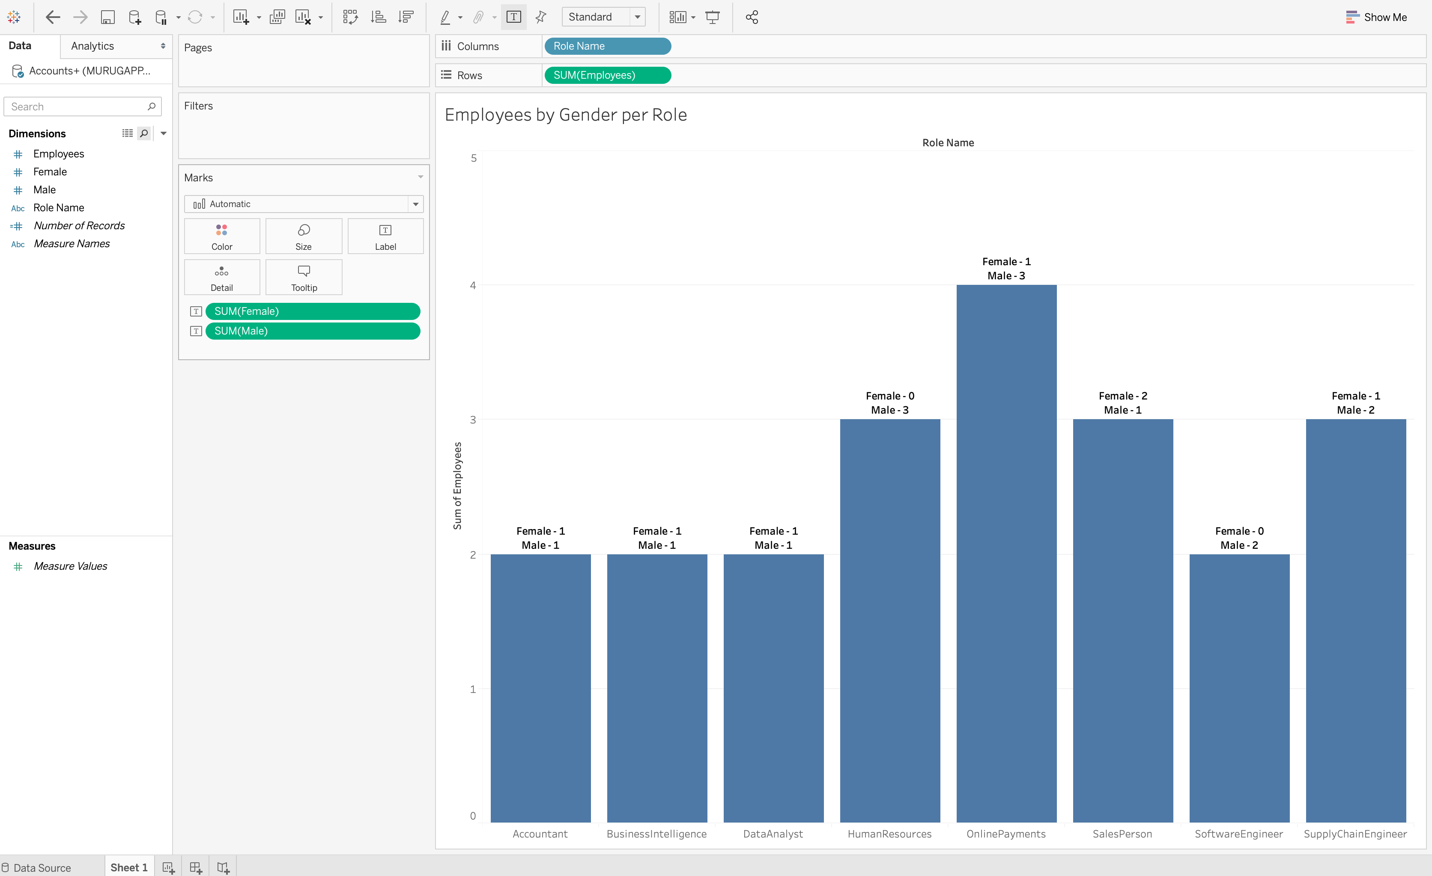
Reports and Visualization
Report primarily shows number of employees for each role.
RoleName on the x-axis
SumOfEmployees on the Y-axis
Additionally, we can also get the count of male and female employees in each role.

Slide 13
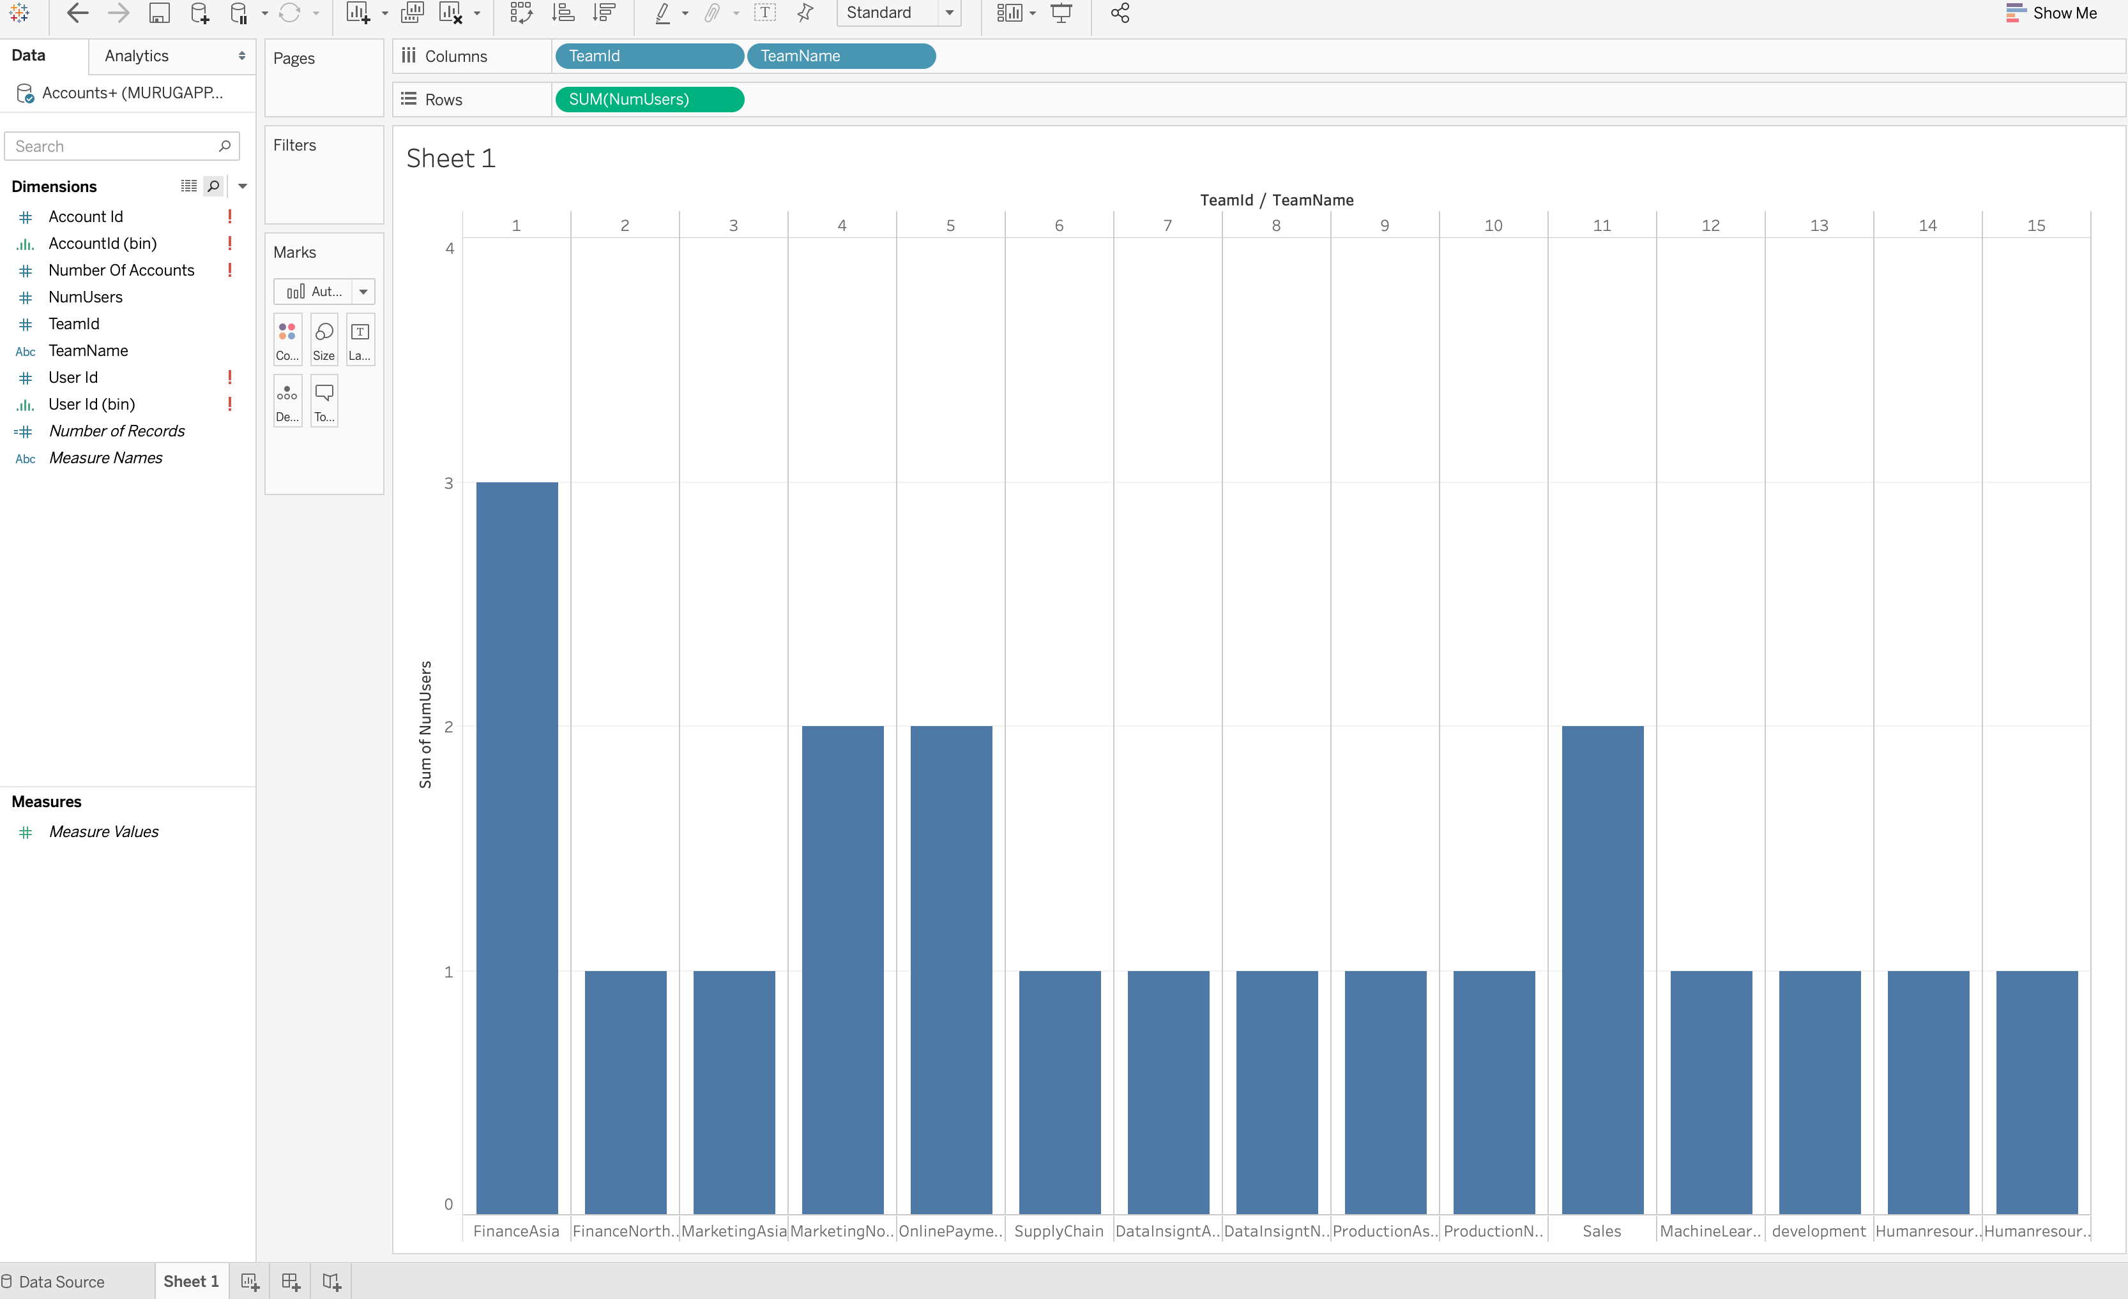
Reports and Visualization
Report shows number of users/employees each team has.
TeamId/Team Name on the x-axis.
Sum of NumUsers on the Y-Axis.

Slide 14

Any questions ?

Slide 15

Thank you

